Slide 1
Demonstration and Study of Bufferbloat in 5G and solution by implementing AQM algorithm CODEL
Team Member:
Sree Prathyush Chinta(CS19BTECH11043)
Medha Rachel Panna(CS22MTECH11003)
Manisha Mahapatra(CS22MTECH14009)
Sohan D P(CS19BTECH11028)
Guidance:
Dr. Bheemarjuna Reddy Tamma
Prof, CSE-IITH
(Course Instructor)
T.A. Mentor:
Harinder Kaur

Slide 2
Problem Statement:
Bufferbloat is an unfavorable condition that frequently occurs in the network and causes end-to-end latency, jitter and performance reduction.
It occurs as a result of lengthy waiting time that absorbs a significant quantity of traffic in a clogged path.
Even very high-speed networks can become virtually unusable for many interactive activities, such as voice over IP (VoIP), audio streaming, online gaming, and even basic web browsing, when a router or switch is set to use very large buffers.

Slide 3
Project Description
There are various scheduling algorithms that are trying to tackle the bufferbloat problem. We aim to showcase the bufferbloat problem in the 5G scenario with the help of ns-3. Taking the base paper on ‘Controlled Delay Active Queue Management’, AQM algorithm that is CoDel (Controlled Delay) is used to solve the bufferbloat problem.
There are two scenarios, first will be to demonstrate the bufferbloat problem in ns3. There is a single UE and a gNB with two downlink flows, one flow is mice flow and the other is elephant flow. In the second scenario, the AQM algorithm that is CoDel is used to solve this problem of bufferbloat.

Slide 4
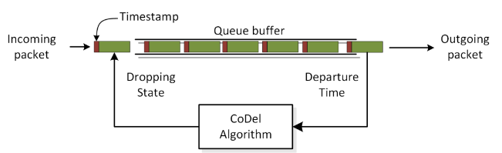
CoDel Algorithm
CoDel is a packet layover time based algorithm. It discards the packets to let the sender's congestion control algorithm know that there is too much buffering going on. It is one of the most well-known AQM and a frequently used fix for the bufferbloat issue.

Slide 5
Project Implementation Details:
Modification in the NS3 code

Slide 6
Explained Using the Code

Slide 7
Challenges Faced
Using the grep command to search through numerous files was a challenge. Additionally, make sure that any modifications made to one file do not have an impact on the other file.
Examining the RLC logs to confirm that the same RLC buffer is used for both downlink flows.
Locating the RLC buffer that has to be modified and verifying that any modifications made don't interfere with the packet-receiving procedure.
Initially our idea was to implement a bufferbloat on the router that will be connected from the gNB to the internet through UPF. We ultimately dropped this strategy after understanding through our research that NS3 has no UPF implementation.
Verification of logs at every step to ensure that the code was functioning properly.

Slide 8
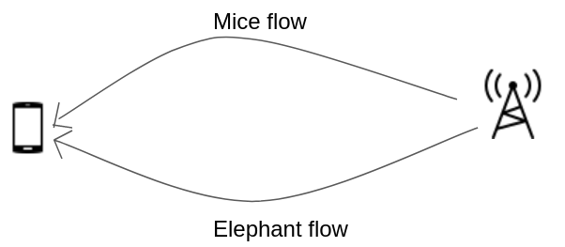
Simulation/Experimental Setup:
Phase 1: Simulation of bufferbloat problem
Simulation of bufferbloat problem in ns3. There are two downlink flows with single UE and a gNB, by setting 1 packet per sec for mice flow and above 15,000 packets per sec for elephant flow.

Slide 9
Phase 2: Solution to Bufferbloat Problem
Implementation 1:
In order to fully utilize the radio channel and to reduce the delay we vary RLC buffer size which thereby changes the delay.
In this implementation we plan to understand the relation between buffer size and the occurring delay for a packet with the help of an experiment ( they are inversely proportional ).

Slide 10
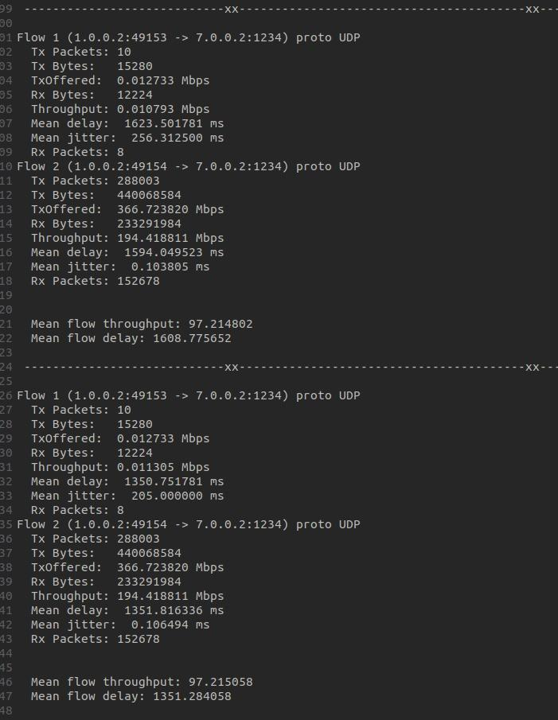

Slide 11
Implementation 2:
Screenshot given below shows the results of CoDel implemented bufferbloat scenario with respect to flow details. First two downlink flows with single UE and a gNB, by setting 1 packet per sec for mice flow and another by setting 15,000 packets per sec for elephant flow.
Next flow is with single UE and gNB by setting elephant flow as 20,000 packets per second.
Initially, there is an undesirable high delay on mice flow caused by varying other network traffic that is the elephant flow causing bufferbloat problem. This problem is solved by implementing the CoDel algorithm on the RLC buffer. The algorithm given below is the implementation of CoDel.

Slide 12
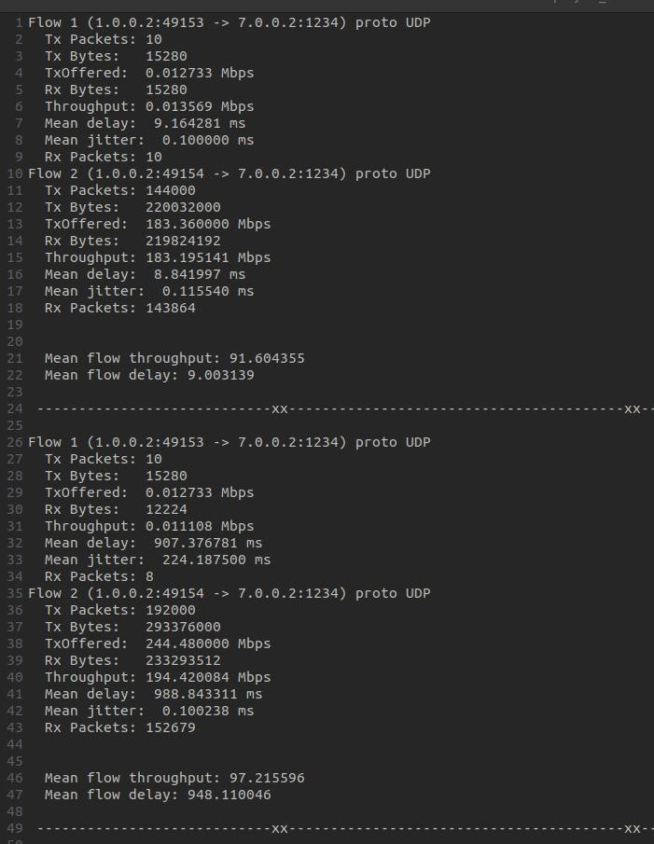

Slide 13
Algorithm:
Step 1:
When a packet is enqueued we attach a timestamp to specify the enqueue time.
Step 2:
Calculating the current queue delay for each packet that is being sent. (cur_qdelay = dequeue time - enqueue time)
Step 3:
When cur_qdelay > threshold for the 1st time, store the current time of the simulation(1st observed delay). This implies that there is a possibility of congestion occurring in the queue.
Step 4:
Continue monitoring the current queue delay of the packets and the moment that the current time - 1st observed delay(‘cur’ in the code) > interval time, we enter the dropping phase.
If at any point the current queue delay is less than the threshold before we reach the interval time we don't enter the dropping phase and reset the values(1st observed delay = 0, count_new = 0, next_drop_time = 0).
Step 5:
When cur_qdelay < threshold then comes out of the dropping phase, the interval timer is reset. It will set again when waiting for the cur_qdelay>threshold.
Dropping phase:
In this phase, we drop the packet that cause to enter this phase while increasing the drop packet counter by one and then calculate the next drop time which is used to calculate the next time at which a packet should be dropped, this calculation given by
next_drop_time = current_time + interval/sqrt(count_new).

Slide 14
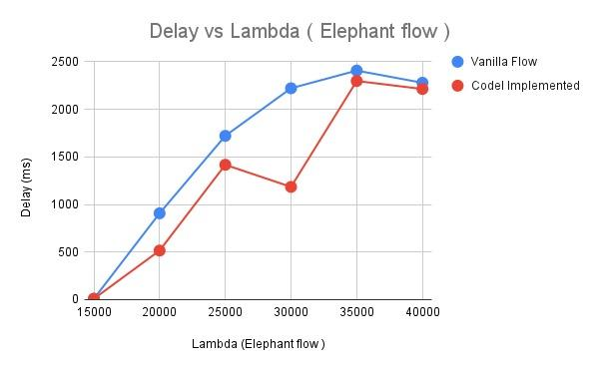
Performance Result:
The two flows in the above graph led us to the conclusion that the delay in the case of the vanilla flow is greater than the delay after the implementation of Codel.

Slide 15
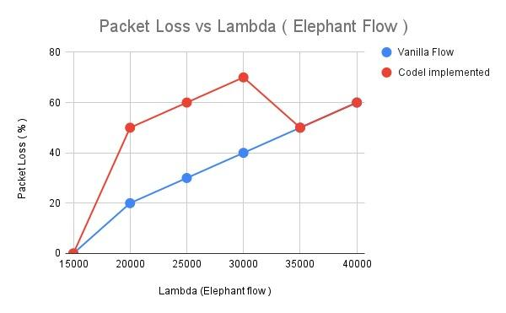
The above graph shows that the packet lost in case of CoDel implementation is higher than the vanilla flow.
The two graphs above demonstrate that the delay decreases when Codel is used, but it's at the expense of greater packet loss when compared to a vanilla flow.

Slide 16
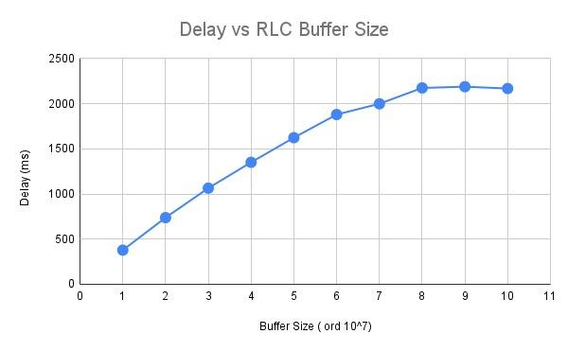
In this graph we observe that the RLC buffer size is inversely proportional to the delay. With the delay appearing to flatten as we approach the higher buffer sizes. This graph has been generated for the elephant flow having the lambda value of 30,000.

Slide 17
Conclusion:
From the graphs and the report we conclude that on implementing the CoDel algorithm we get a better delay even though there is some packet loss and by manipulating the parameters such as threshold and interval of CoDel we can get an optimal condition where we can have good improvement in delay without great packet loss percentage.

Slide 18
Future Description:
The current implementation can be extended to the other mode of the RLC i.e. the AM mode since our current implementation is only in the UM mode.
A proper implementation of the CoDel algorithm can be done which involves creation of a CoDel.h,CoDel.cc and a Queue.cc, Queue.h file that involve in creation of the queue for the RLC as well as are involved in its maintenance allows multiple algorithms to be created that can simply be extended to this Queue.
Implementing other AQM algorithms mentioned in the Dynamic Buffer Sizing paper to compare them to give the required result.
Implementation of a UPF to be able to demonstrate the router based implementation where the GNB is connected to the Internet through the router( connected via the UPF).
The current buffer size manipulation program requires us to manually change the buffer size, can implement a dynamic buffer sizing algorithm to compare their performance with the respective AQM algorithms.

Slide 19
Reference
Base Paper : Nichols, K.; Jacobson, V.; McGregor, A.; Iyengar, J. Controlled Delay Active Queue Management. RFC 8289. January 2018. Available online: https://tools.ietf.org/html/rfc8289
Mikel Irazabal, Elena Lopez-Aguilera, Ilker Demirkol, Navid Nikaein, "Dynamic Buffer Sizing and Pacing as Enablers of 5G Low-Latency Services", IEEE Transactions on Mobile Computing, vol.21, no.3, pp.926-939, 2022.
https://www.ericsson.com/en/reports-and-papers/ericsson-technology-review/articles/virtual-aqm-for-mobile-networks
Bufferbloat Demo at IETF 86 - YouTube
http://ce.sc.edu/cyberinfra/workshops/Material/NTP/Lab%2018.pdf

Slide 20
Team Contribution
Medha: When through the research papers to find the base paper for project implementation. Involved in base case scenario, and in verifying RLC logs. Tried implementing CoDel on the router connecting from the gNB to the internet. Involved in writing the report and the presentation making.
Prathyush: Wrote the code for the codel implementation,was a part of writing the code for the base case scenario, generated the graphs and output files for the report and was involved in the report writing as well as presentation making process.
Manisha: Was involved in the pgw based implementation for the router connection to the internet and involved in a part of the report writing.

Slide 21
Thank You!

